Slide 1
Garbage Waste Detection using Image Processing
Team Members
1.N.Ganesh - 16R21A0580
2.N.Likhitha - 16R21A0598
3.P.Varesh - 16R21A05A5
4.B.Jagadeesh - 16R21A0567
Internal Guide
Kashi Sai Prasad Sir
Assistant Professor
Department of Computer Science and Engineering

Slide 2
Problem Statement
The Garbage collection become a major concern for the municipal department of the area. The garbage or waste materials are thrown to the road side areas. The tracking of Garbage waste becomes very important aspect of Smart cities under Waste Management.
There should be an application which helps user to detect the garbage and notifies to the concern department about the garbage waste.
Notes:
Jagadesh

Slide 3
Introduction
In today’s world, garbage disposal has become a cause of major concern.
An astounding amount of 0.1 million tons of waste is generated each day in our country.
Unfortunately, only 5% of this colossal amount of waste is recycled.
The huge amount of waste that is generated gets disposed by means which have an adverse effect on the environment due to improper waste management.
Several advancements in technology has made it possible to convert waste items into useful sources of energy.
Notes:
Jagadesh

Slide 4
Literature Survey
Manual Garbage Collection
The old method is used by anyone who pass through garbage in the roadside area.
They generally try to call municipal corporation and give complaint for the same.
Their calls are not answered always and many a time, location is also a proper for identifying the garbage heap.
The success rate of the garbage collected cannot be predicted in this case. It might take lot many days to remove the waste garbage.
Waste Garbage Segregation
This Method is used to segregate the waste garbage upon dry and wet garbage.
Garbage segregation can be performed with the help of IOT, Image Processing.
There ae many industries which use these technologies for garbage separation.
Dry waste includes things like wood, metal, glass and wet waste include vegetable waste, raw materials.
Notes:
jagadesh

Slide 5
Proposed System
This Method is very easy and helpful for everyone to keep surrounding clean.
Our Application clicks an image and detects the garbage from the image.
If the garbage is detected from the image then GPS location of the garbage from the app will be send to the concern department so that they will come and remove the waste garbage from the particular location.
This will help us to keep our surroundings neat and clean.
The model is trained from AutoML Edge with the accuracy of more than 75%.
Notes:
jagadesh

Slide 6
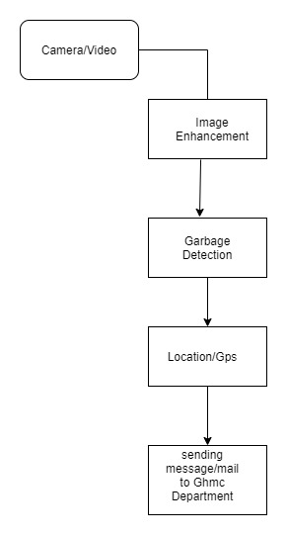
ARCHITECTURE OF THE PROJECT
Notes:
ganesh

Slide 7
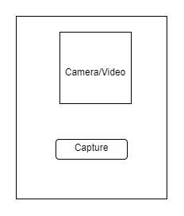
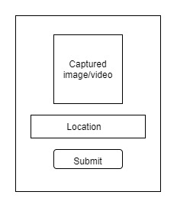
MODULES OF THE PROJECT
Notes:
ganesh

Slide 8
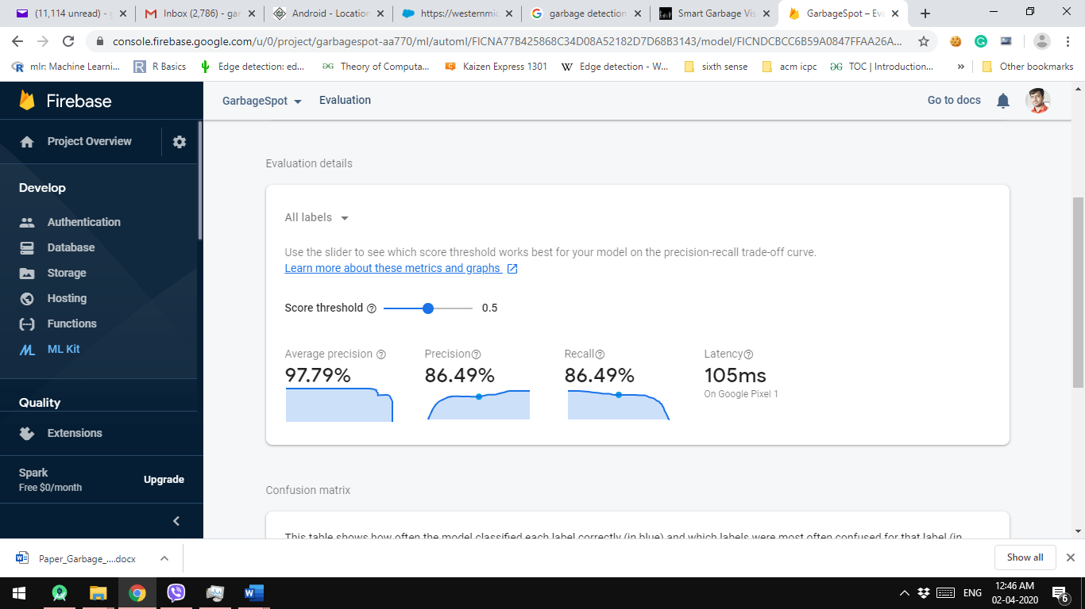
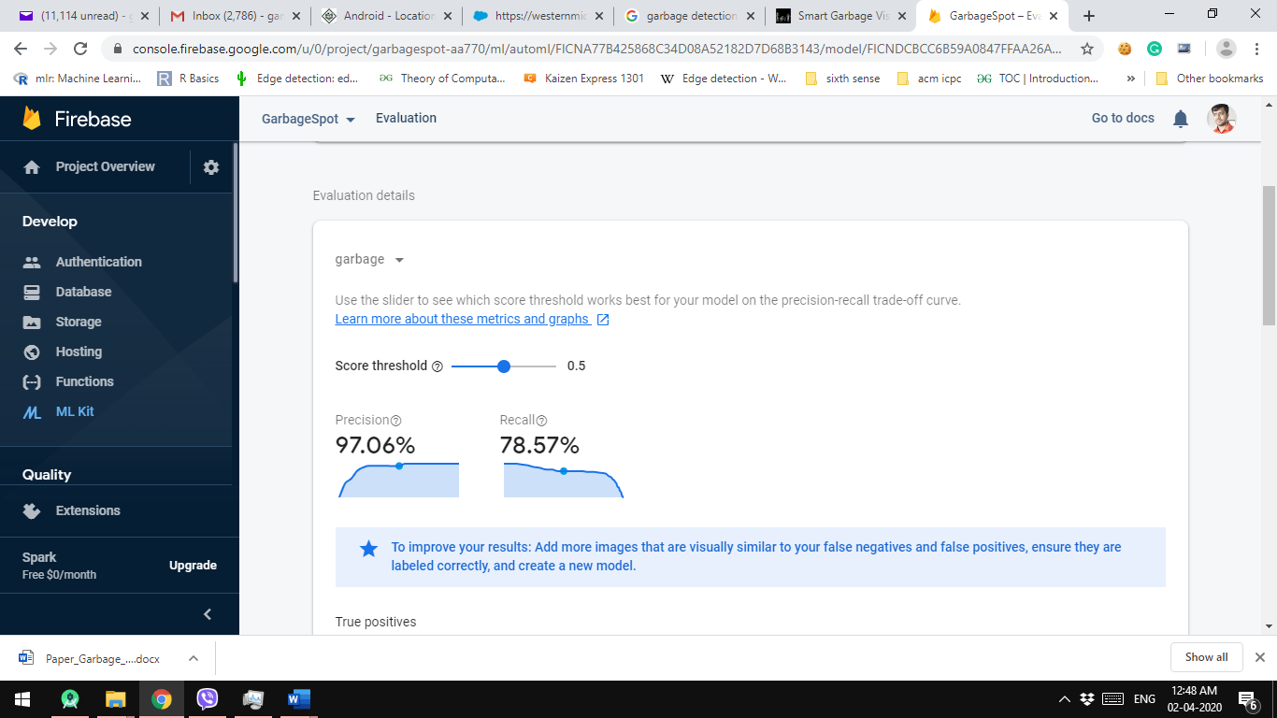
Model Evaluation
Notes:
ganesh

Slide 9
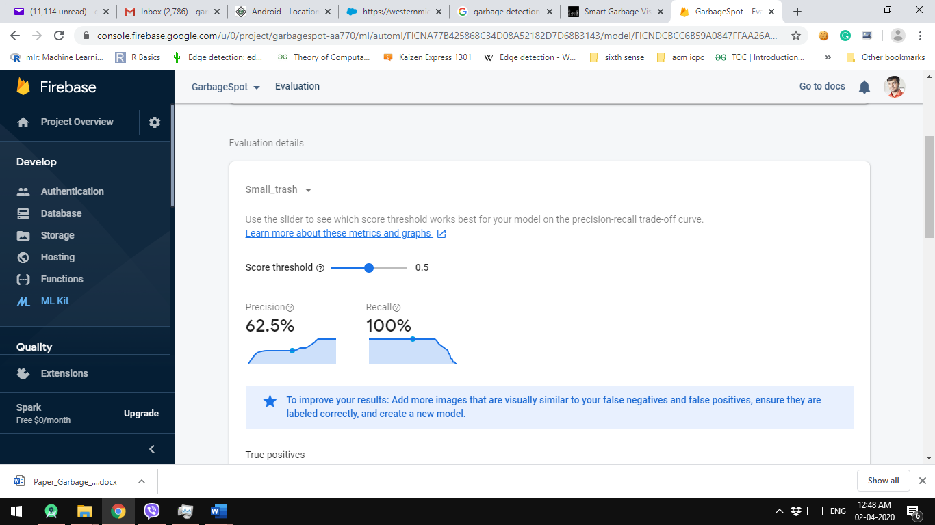
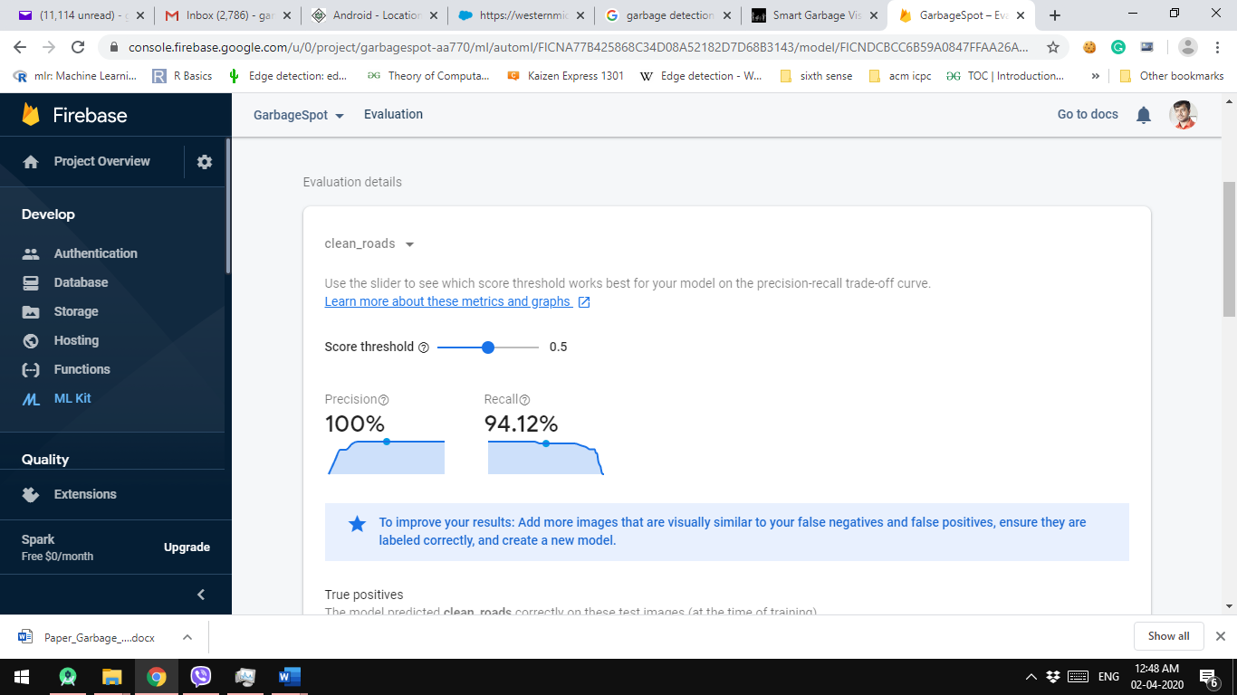
Notes:
ganesh

Slide 10
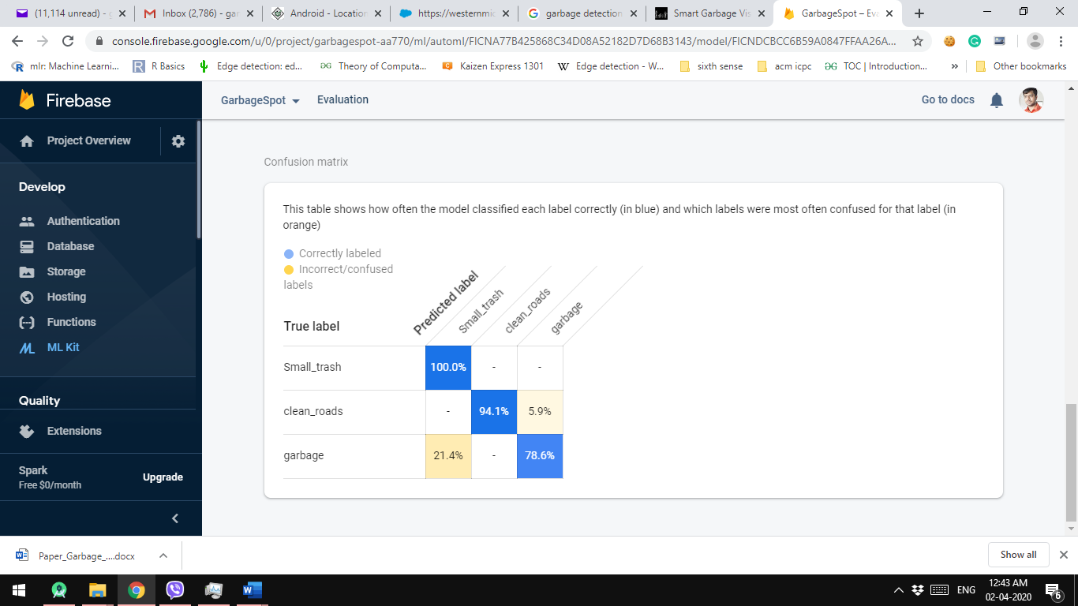
Confusion Matrix
Notes:
ganesh

Slide 11
Algorithms (Model Creation)
The application called AutoML Vision object Detection is been used for training the model.
Cloud AutoML is a suite of machine learning products that enables developers with limited machine learning expertise to train high-quality models specific to their business needs. It relies on Google’s state-of-the-art transfer learning and neural architecture search technology.
The logic of AutoML works using reinforcement learning and recurrent neural network. To start with RNN will propose a random set of hyper-parameters such as nodes per layer, layer count etc then model will be build with such parameters.
Hardware architectures supported: Edge TPUs, ARM and NVIDIA.

Slide 12
Technology
Android Studio
TensorFlow Lite Model
Firebase
Mobile Application Development
GPS based Location System
Machine Learning
Notes:
likhitha

Slide 13
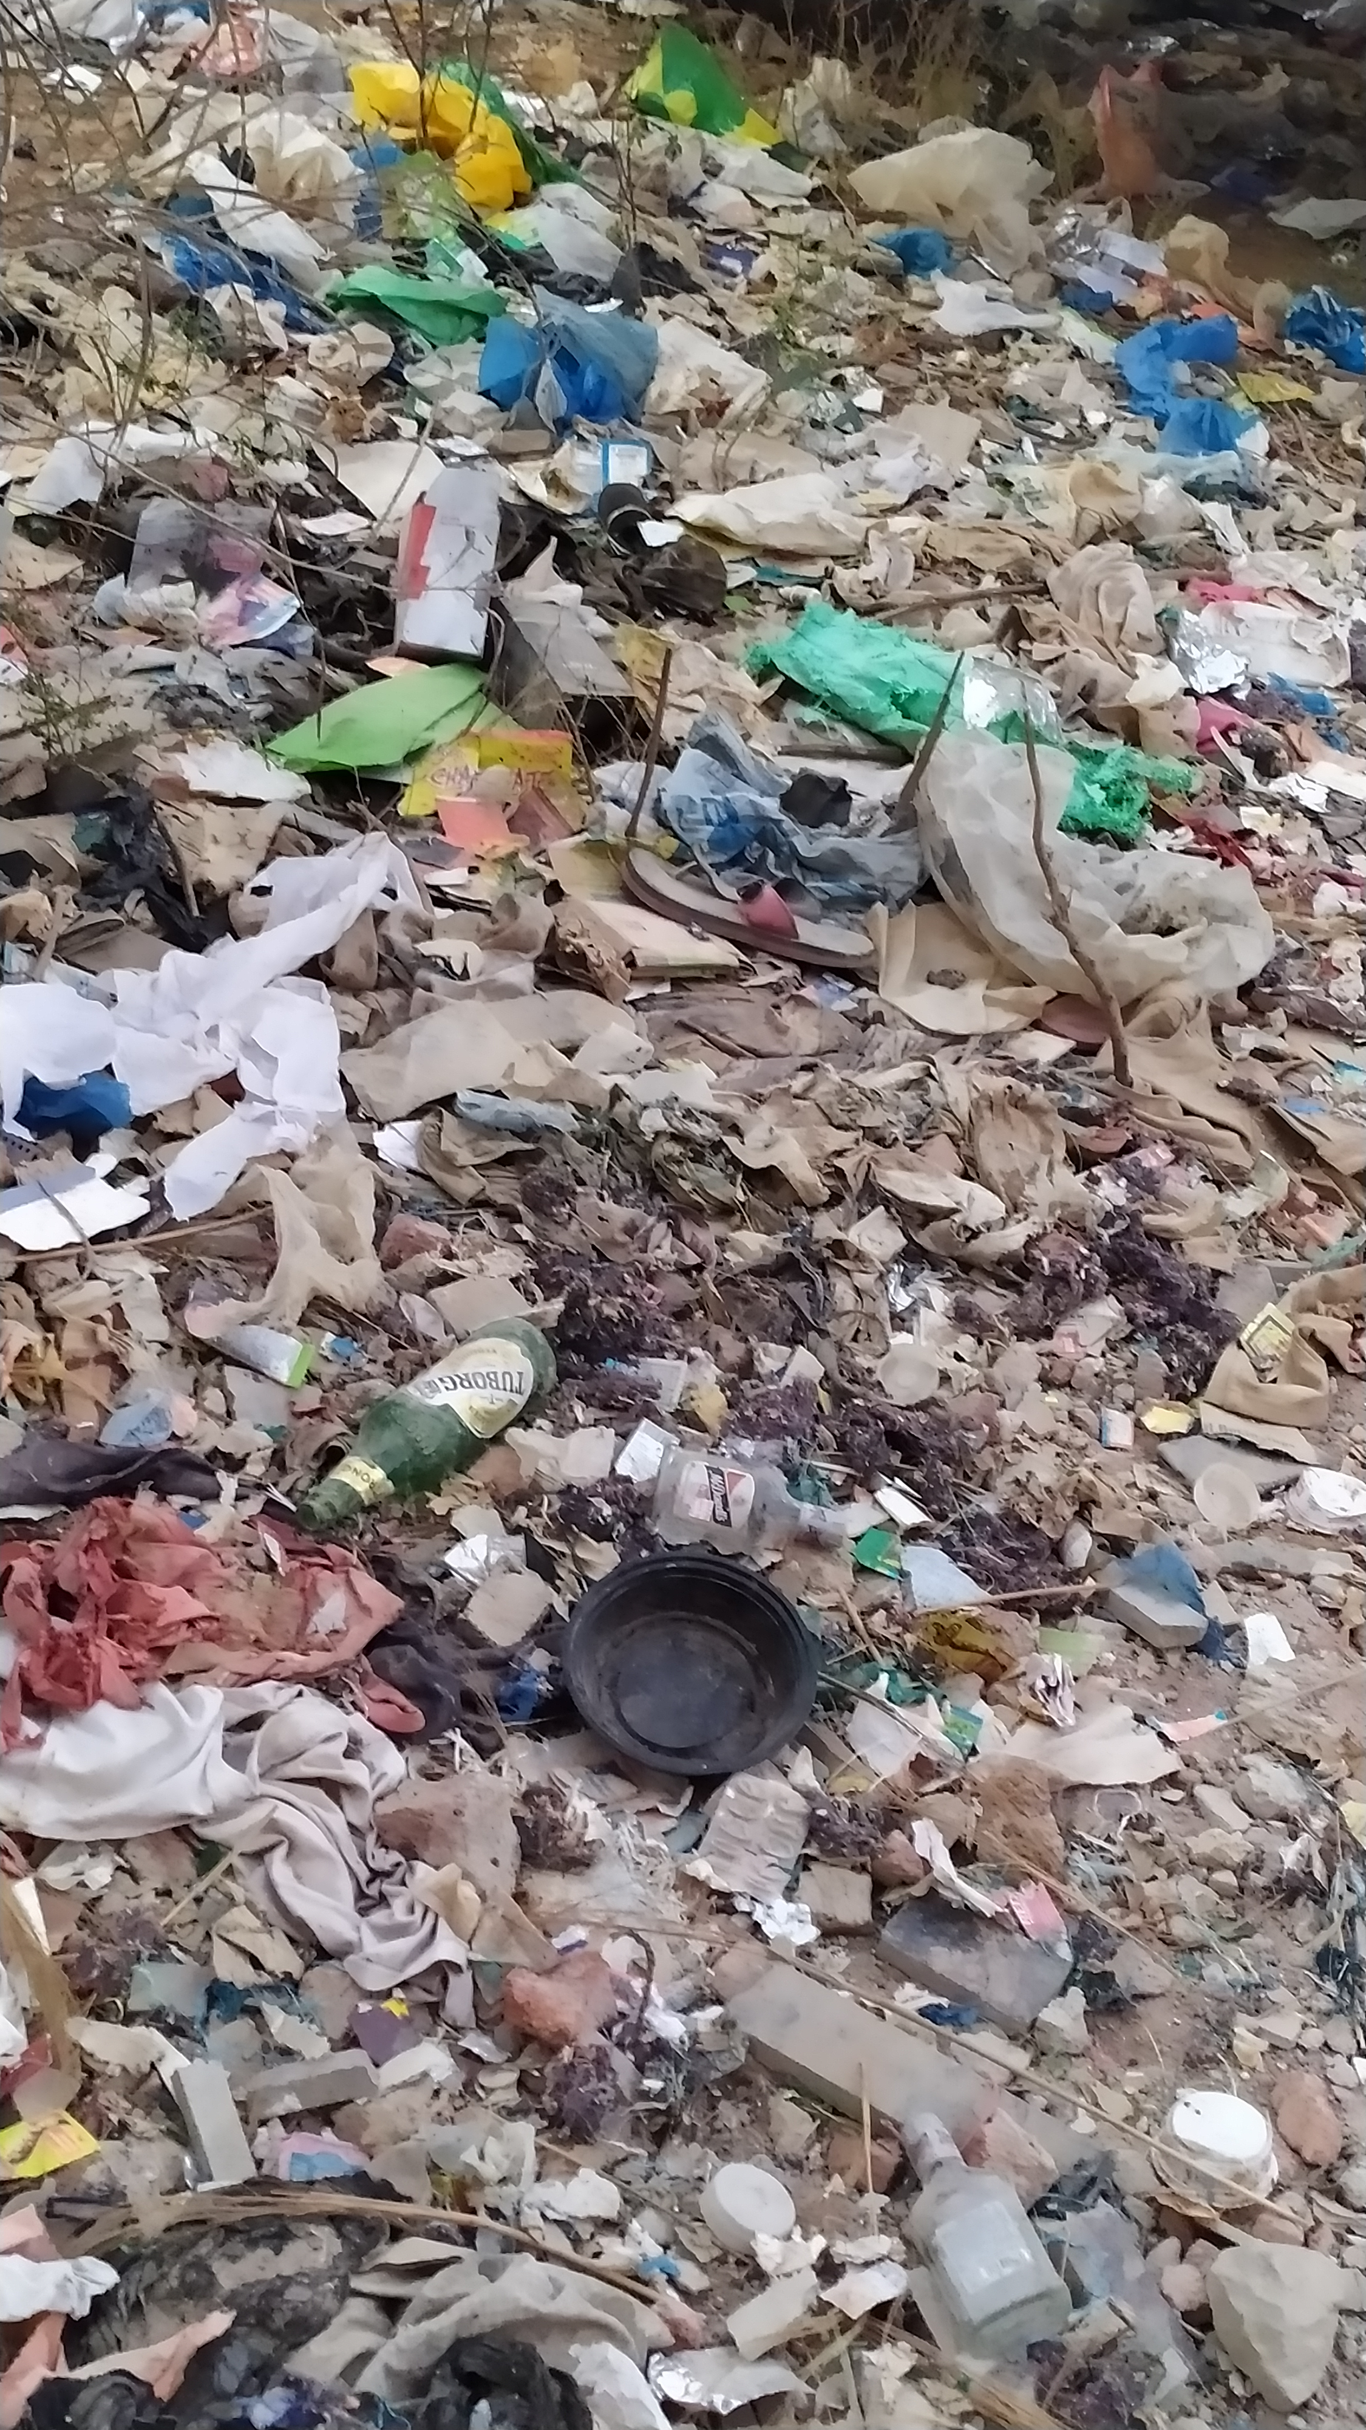
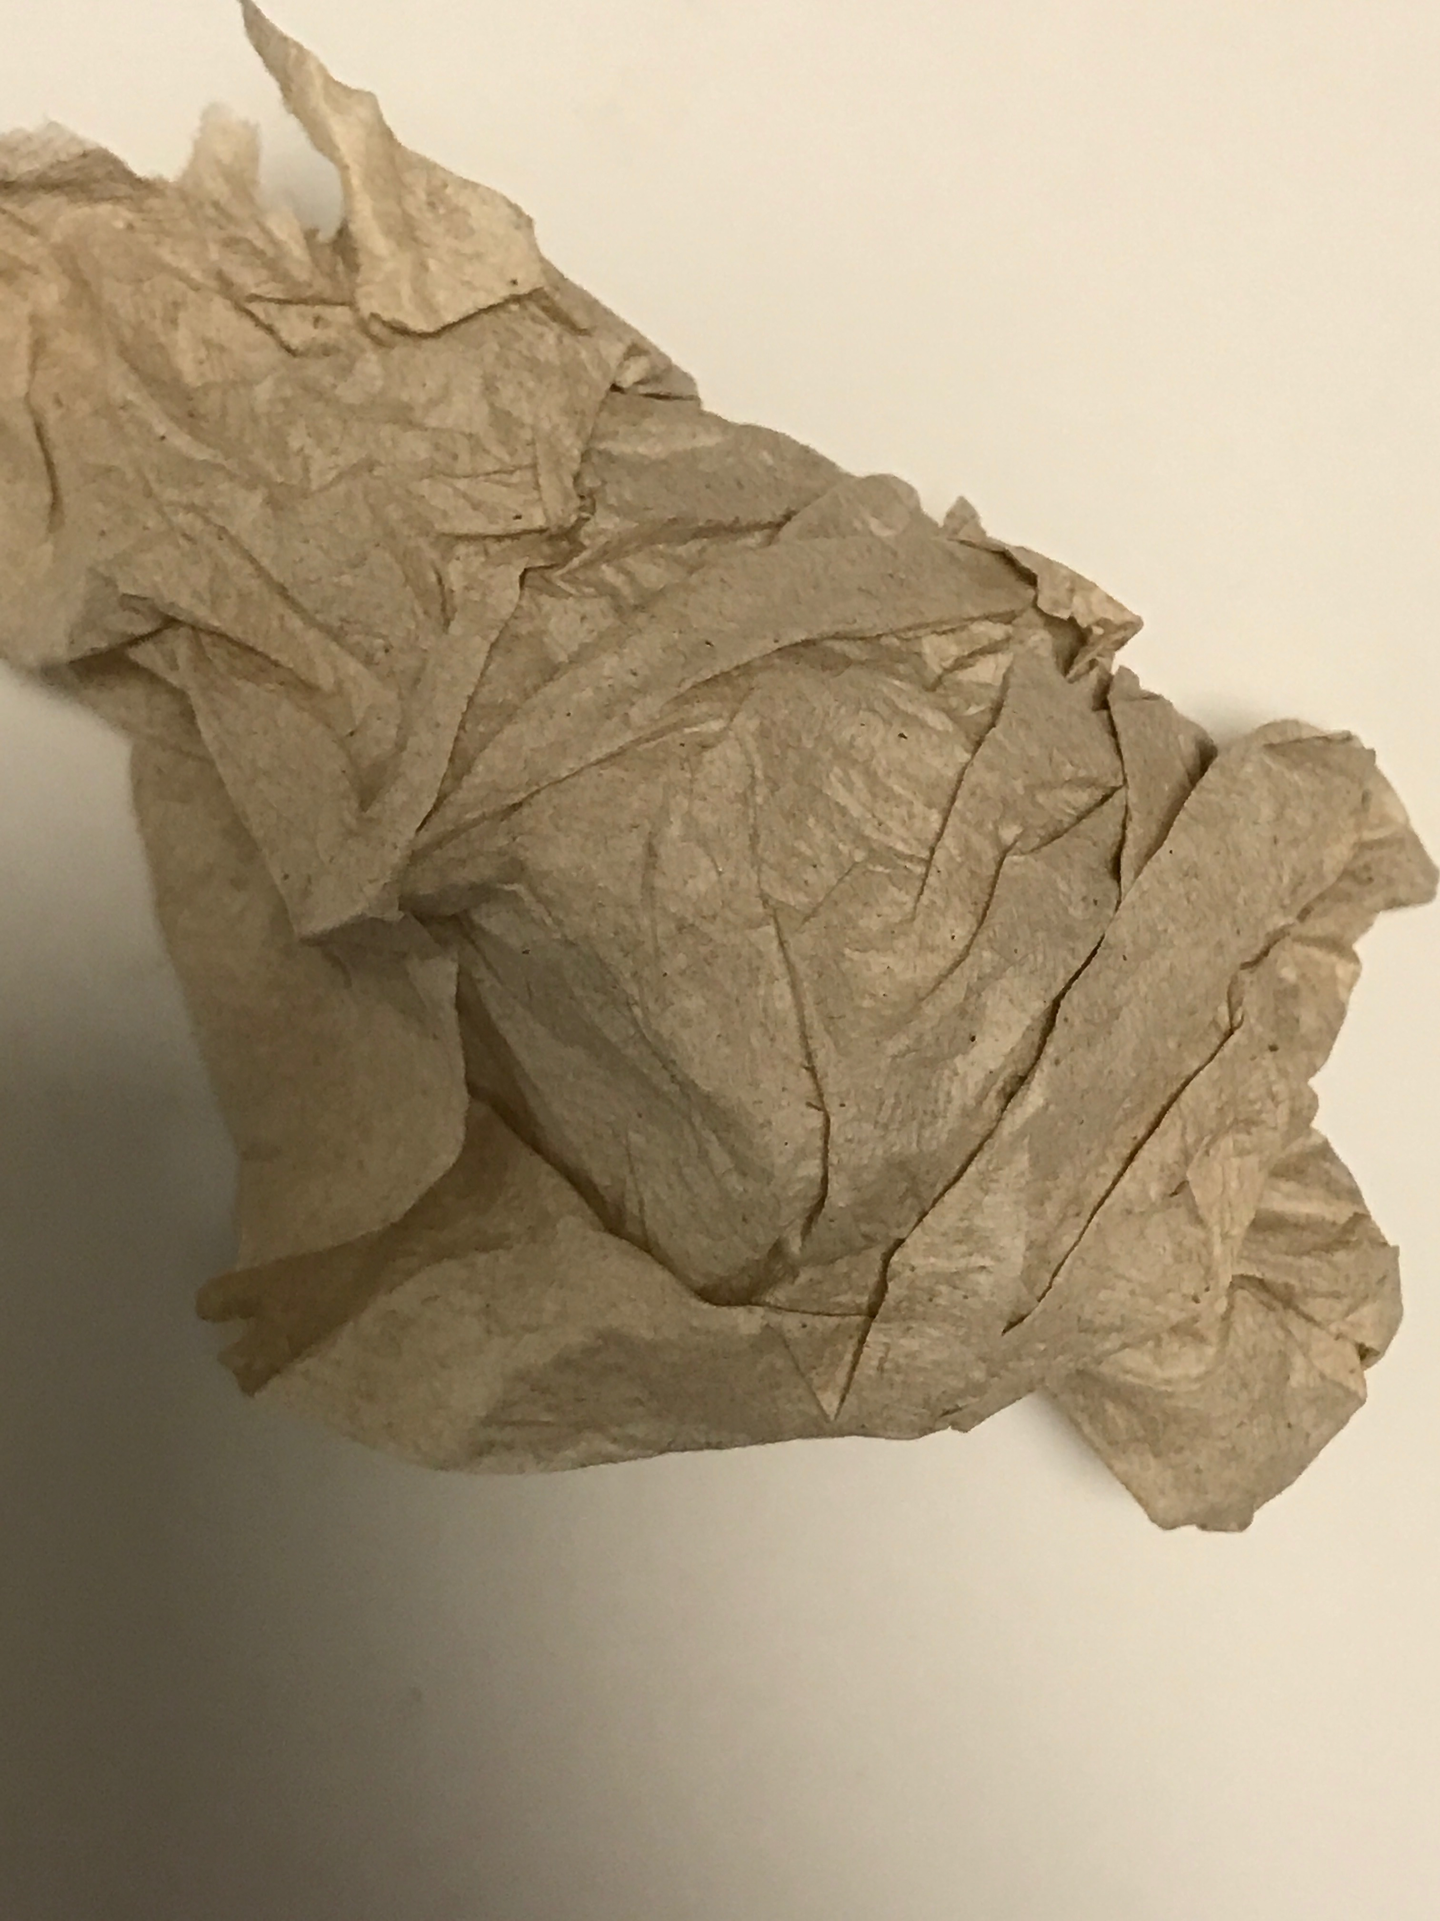
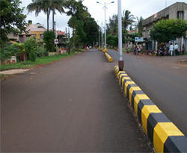
Datasets
There are three types of Datasets in the Garbage Detection Model. They are classified as follows:
Garbage – 75% to 80%
Small Trash – 60 % to 65%
Clean Roads – 90% to 95 %

Slide 14
SAMPLE CODE
protected void onCreate(Bundle savedInstanceState)
{
super.onCreate(savedInstanceState);
setContentView(R.layout.activity_main);
cameraView = findViewById(R.id.cameraView);
imageViewResult = findViewById(R.id.imageViewResult);
textViewResult = findViewById(R.id.textViewResult);
textViewResult.setMovementMethod(new ScrollingMovementMethod()); btnToggleCamera = findViewById(R.id.btnToggleCamera);
btnDetectObject = findViewById(R.id.btnDetectObject);
cameraView.addCameraKitListener(new CameraKitEventListener()
{ @Override public void onEvent(CameraKitEvent cameraKitEvent) { }
@Override public void onError(CameraKitError cameraKitError) { } @Override public void onImage(CameraKitImage cameraKitImage)
{
Bitmap bitmap = cameraKitImage.getBitmap();
bitmap = Bitmap.createScaledBitmap(bitmap, INPUT_SIZE, INPUT_SIZE, false);
imageViewResult.setImageBitmap(bitmap);
final List<Classifier.Recognition> results = classifier.recognizeImage(bitmap);
detect_value=results.get(0).toString();
textViewResult.setText(detect_value);
}
@Override public void onVideo(CameraKitVideo cameraKitVideo) { } });
btnToggleCamera.setOnClickListener(new View.OnClickListener() { @Override public void onClick(View v) { cameraView.toggleFacing();
} });
btnDetectObject.setOnClickListener(new View.OnClickListener() { @Override public void onClick(View v) { cameraView.captureImage(); if (detect_value.contains("garbage")) { Toast.makeText(getApplicationContext(),"Garbage detected",Toast.LENGTH_LONG).show(); Intent intent=new Intent(MainActivity.this,Main3Activity.class); startActivity(intent); } else Toast.makeText(getApplicationContext(),"Garbage not detected",Toast.LENGTH_LONG).show(); } });
initTensorFlowAndLoadModel(); }
Notes:
Likhitha

Slide 15
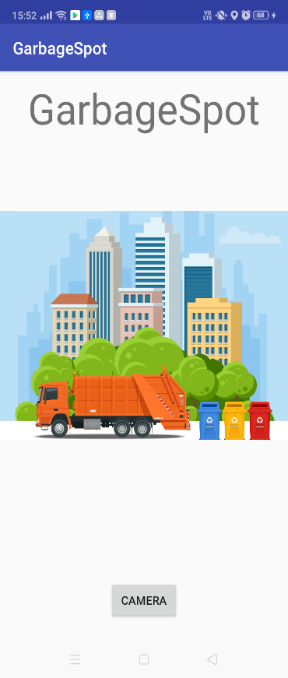
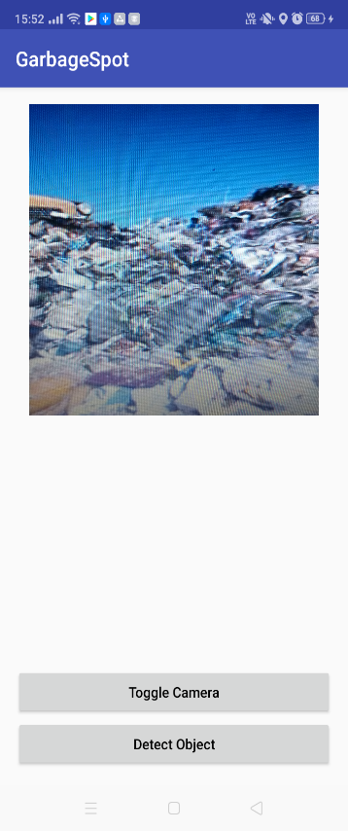
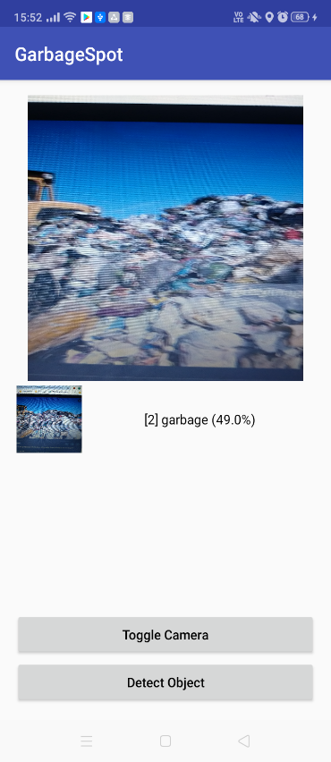
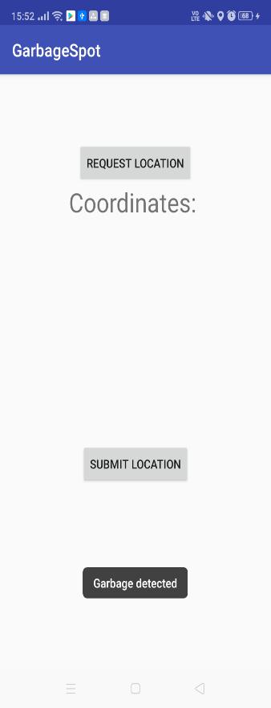
Output Screenshots
Notes:
Likhitha

Slide 16
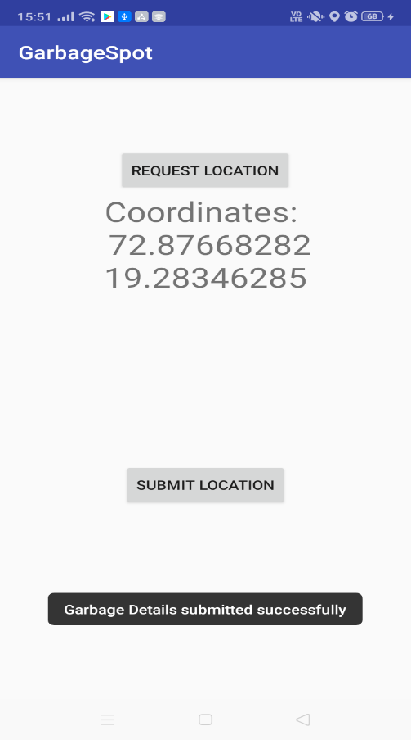
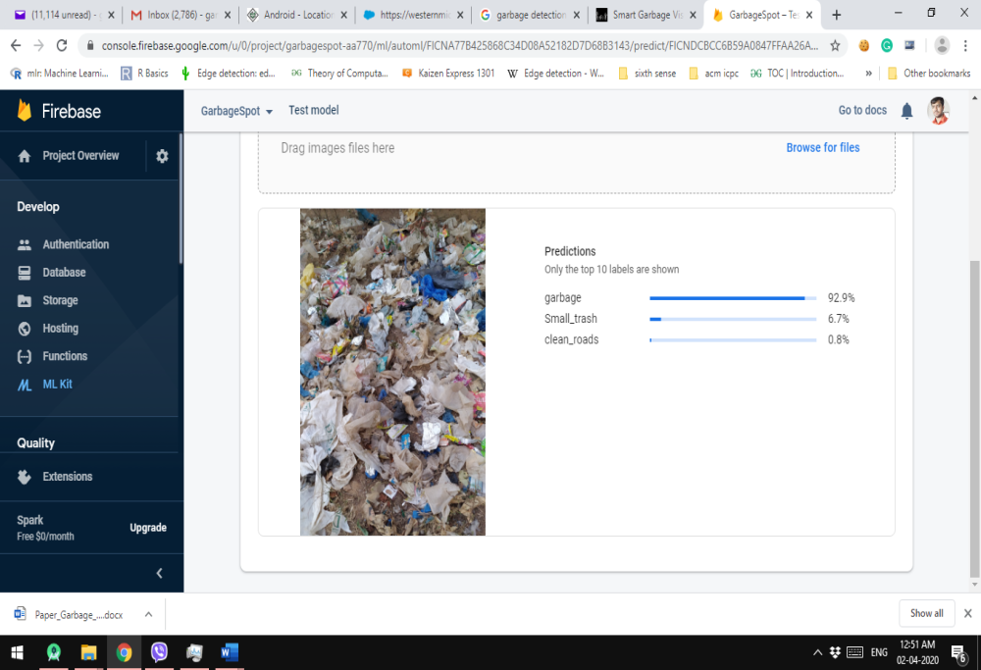
Evaluation (OUTPUT)
Model Evaluation
Mobile Application Evaluation
Notes:
Likhitha

Slide 17
CONCLUSION
This System will be helpful to make our surrounding neat and clean.
With this system there would not be any spreading of diseases.
Immediate interaction with the concern department will help to make the roads and public places clean and green.
Advance technology is been used for good purpose.
Notes:
ganesh

Slide 18
Future Work
This System will be helpful to make our surrounding neat and clean.
This System would help for not spreading diseases through the waste.
Immediate interaction with the concern department will help to make the roads and public places clean and green.
Advanced technology is been used for good purpose.
Notes:
ganesh

Slide 19
Reference
Anjali Pradipbhai Anadkat, B V Monisha, Manasa Puthineedi, Ankit Kumar Patnaik, Dr. Shekhar R, Riyaz Syed “Drone based Solid Waste Detection using Deep Learning & Image Processing” Alliance International Conference on Artificial Intelligence and Machine Learning (AICAAM), on April 2019.
K. Sai Prasad & Rajender Miryala “Histopathological Image Classification Using Deep Learning Techniques” International Journal on Emerging Technologies 10(2): 467-473 (2019).
Alvaro Salmador, Javier Pérez Cid, Ignacio Rodríguez Novelle “Intelligent Garbage Classifier” International Journal of Interactive Multimedia and Artificial Intelligence, Vol. 1, Nº 1, ISSN 1989-1660.
Saravana kannan G, Sasi kumar S, Ragavan R, Balakrishnan M “Automatic Garbage Separation Robot Using Image Processing Technique” International Journal of Scientific and Research Publications, Volume 6, Issue 4, April 2016.
Notes:
ganesh

Slide 20


